Slide 1
Monetary and Fiscal Policy Effects on the Economy
AP Macroeconomics
Mrs. Shackett

Slide 2
White boards 2 AS/AD diagrams in LR equilibrium 1 AD ↑, 1 AS ↑

Slide 3
Monetary and fiscal policy goals
Employment
Stable prices
Economic growth
Notes:
MP and FP shift AD.
Ask how a shift in AS could lead to desired outcomes. Draw AS/AD, shift AS right.

Slide 4
Supply-side policies
technological advance
Policies that improve productivity

Slide 5
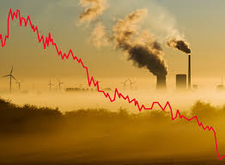
Supply-side policies
labor and energy
Policies that decrease the price of economy-wide inputs

Slide 6
Supply-side policies
Policies that increase quantity or quality of resources

Slide 7
Expansionary Monetary Policy
Aggregate S & D Money Market Investment
PL
Nom. Int. rate
Real Interest rate
rGDP Quantity of money Quantity of investment

Slide 8
handout, questions 1-4

Slide 9
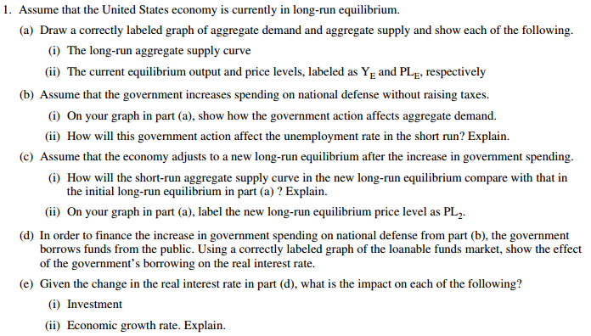
2010 #1

Slide 10
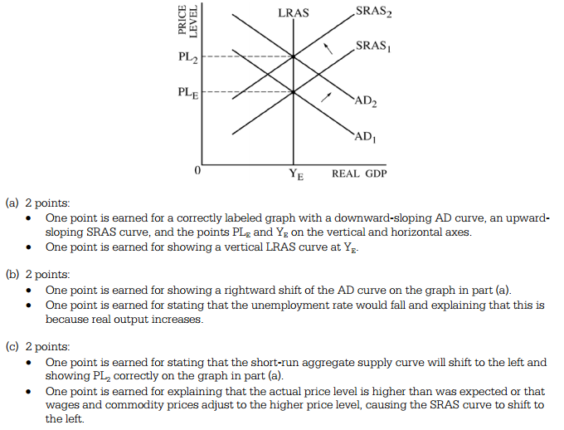

Slide 11
Now, handout, questions 5-7

