Slide 1
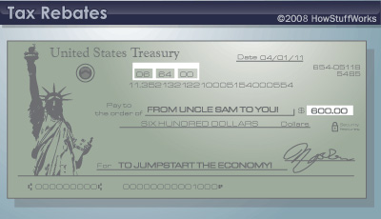
Fiscal Policy

Slide 2
Legislative Mandates
Employment Act of 1946
Commits the Federal government to use all practicable means, consistent with the market system to “create economic conditions under which there will be…employment opportunities, including self-employment, for those able, willing and seeking work, and to promote maximum employment, production, and purchasing power.

Slide 3
Fiscal Policy as a Tool
Fiscal Policy is the use of government spending and revenue collection (taxes) to influence the economy
Spending affects the DEMAND for goods and services

Slide 4
Expansionary Fiscal Policy
AS
P₁
Price level
P₀
AD₀
AD₁
Y₀ Y₁
Real GDP (billions)

Slide 5
Expansionary Fiscal Policy
To Reduce Unemployment…
Increase Government Spending
Tax Reductions
Rather than increasing its own spending, government can cut taxes to increase consumption or investment spending.
Lowering taxes increases disposable income.
Disposable income is after-tax income of consumers.
Combinations of the Two

Slide 6
Contractionary Fiscal Policy
AS
PRICE LEVEL (average price)
P₁
Budget cuts and tax hikes decrease AD
P₂
AD₃
AD₄
REAL OUTPUT (quantity per year)

Slide 7
Contractionary Fiscal Policy
To Reduce Inflation…
Decrease Government Spending
Cutbacks in government spending directly reduce aggregate demand.
Tax Increases
Tax hikes reduce disposable income and thus reduce consumption.
Shift the aggregate demand curve to the left.
Tax increases have been used to “cool” the economy.
The Equity and Fiscal Responsibility Act of 1982 increased taxes to reduce inflationary pressures.
Combinations of the Two

Slide 8
Fiscal Policy Guidelines
The fiscal strategy for attaining the goal of full employment is to shift the aggregate demand curve
Expansionary
Contractionary

Slide 9
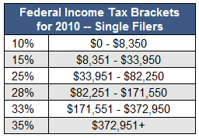
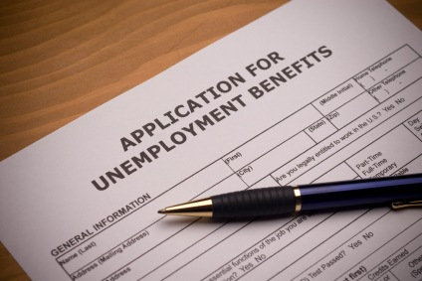
Automatic Stabilizers
0
Changes in fiscal policy that correct AD without policymakers having to take any deliberate action

Slide 10
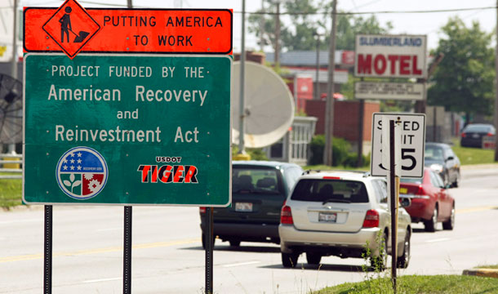
Discretionary Stabilizers
Require deliberate action

Slide 11
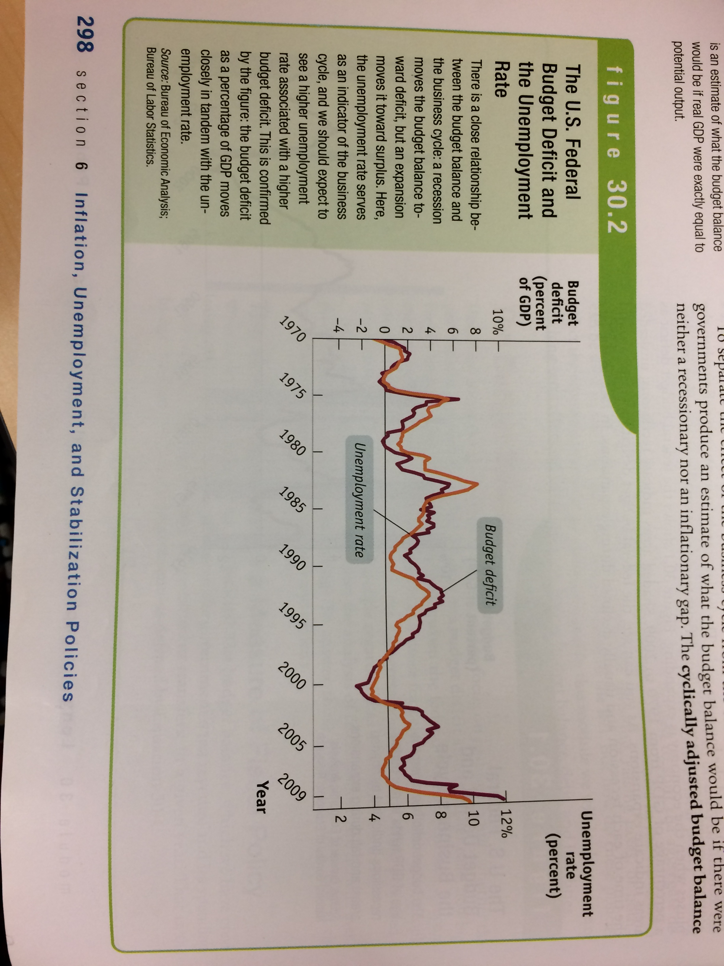

Slide 12
Election Economics

Slide 13
Federal Budget
The taxing and spending plan of the national government

Slide 14
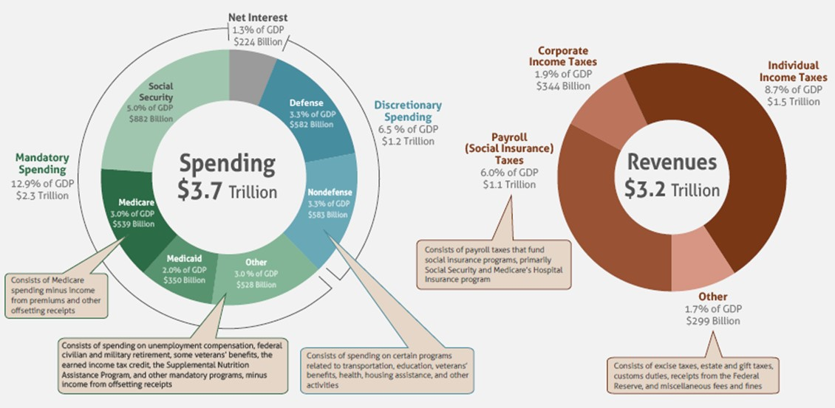
A look at the 2015 federal budget
When government spending is greater than tax collections, the result is a budget deficit; the federal government then must borrow money to fund its deficit spending
Source: Congressional Budget Office

Slide 15
The federal government has run a deficit for much of the last century
Source: FRED Economic Data, Federal Reserve Bank of St. Louis

Slide 16
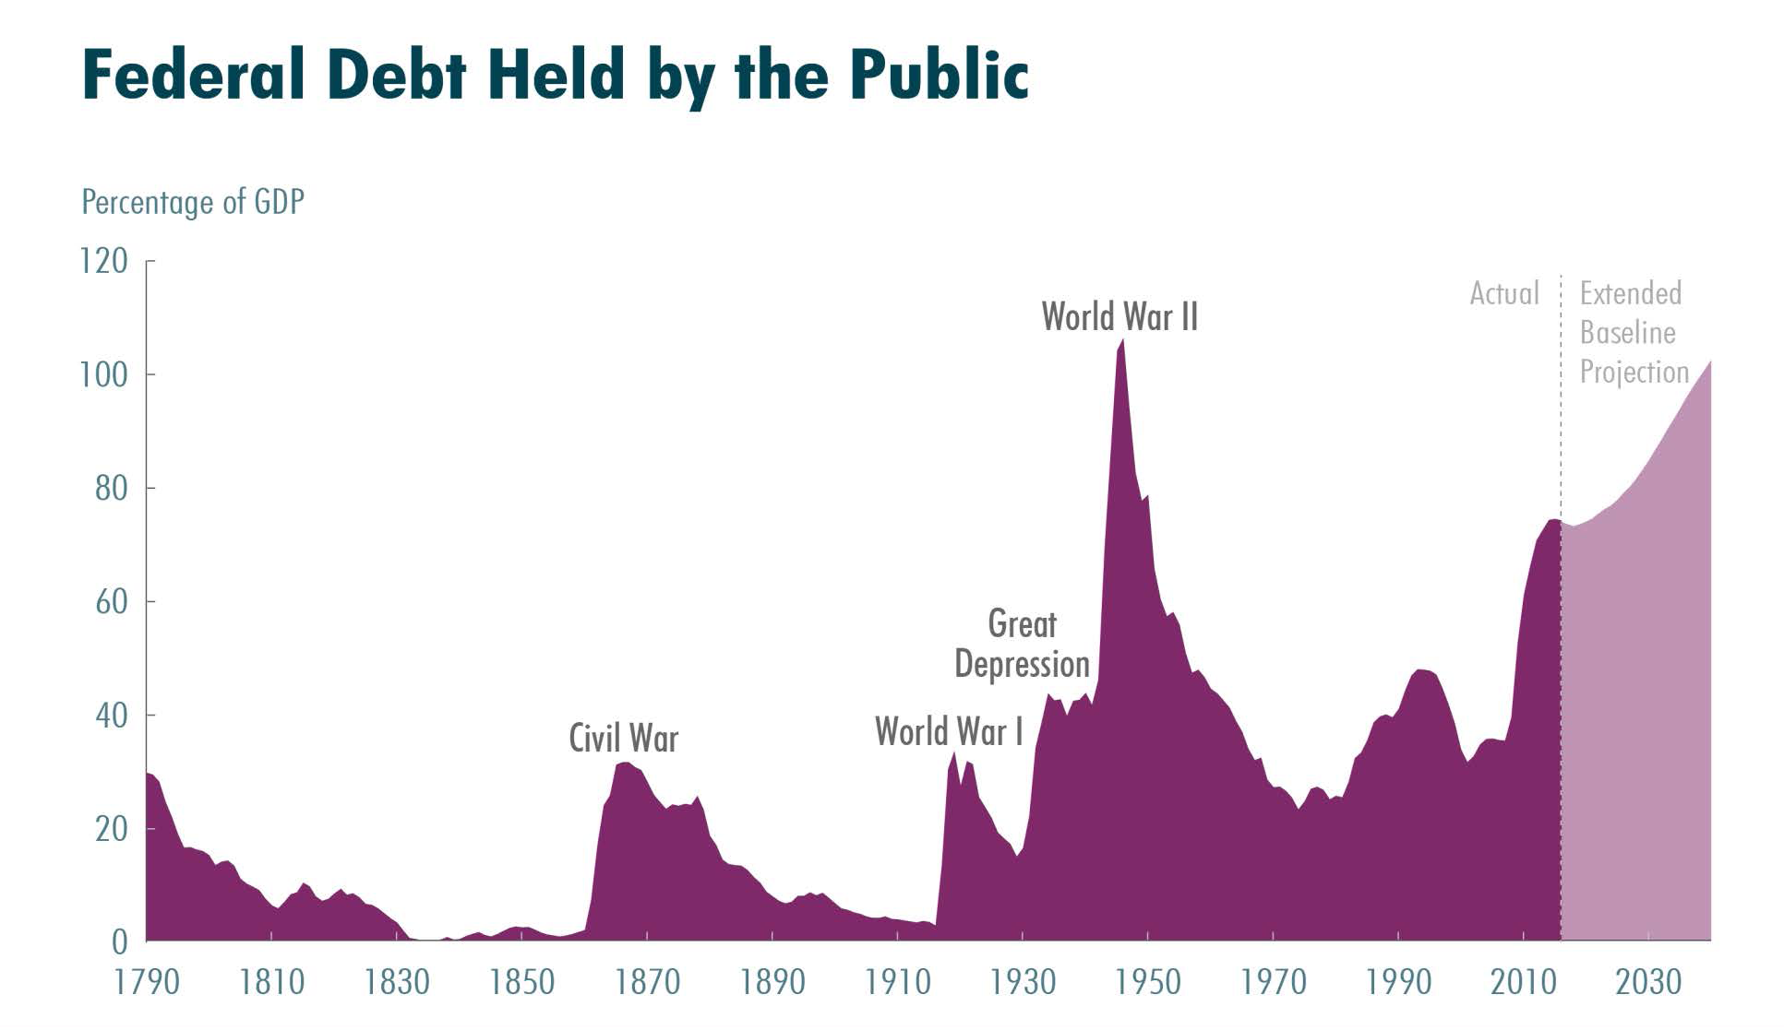
A yearly deficit adds to the national debt
Source: Congressional Budget Office, “The 2015 Long-Term Budget Outlook,” June 16, 2015

Slide 17
The long-term federal budget outlook
The long-term federal budget outlook has worsened dramatically in recent years
Federal debt as a % of GDP is higher than at any time since WWII
The CBO projects that growing budget deficits will push debt well above its current high level → in 25 years, federal debt will exceed 100% of GDP and still be on an upward path
The policy changes needed to reduce debt will become larger and larger over time

Slide 18
What consequences would a large and growing federal debt have?
The larger a government’s debt, the greater the risk of a fiscal crisis
Significant negative consequences of a large and growing federal debt:
Large amount of federal borrowing would draw money away from private investment in productive capital over the long term
↑ federal spending on interest payments →
↑taxes, ↓ spending on benefits/services, or both
Large amount of debt would restrict policymakers’ ability to use tax and spending policies to respond to unexpected challenges

Slide 19
You need to captain the U.S.S. Federal Budget to avoid the stormy seas of debt.
Your mission is to pick from a menu of tax and spending options to reduce the debt from projected levels over the next 25 years and keep the debt level no higher than it is today.
But budget decisions aren’t only about fiscal sustainability. They also shape the kind of country we live in. To win the game, you need to find a combination of policies that match your values and priorities AND set the budget on a sustainable course.
Before we begin the game, you’ll select your governing goals. The goals are your aspirations and values – the ones that shape the kind of country we live in. You need to pick up to three.

Slide 20
Your governing goals – Template for discussing with your partner
Partner #1 Explain:
Which goals did you choose?
Why did you choose these goals?
Discuss together: Do partner #1’s goals work in concert with each other so that he/she will be able to achieve his/her objectives? Do they balance both revenues and expenditures so that you will be able to put the country on a sustainable fiscal path?
Partner #2 Explain:
Which goals did you choose?
Why did you choose these goals?
Discuss together: Do partner #2’s goals work in concert with each other so that he/she will be able to achieve his/her objectives? Do they balance both revenues and expenditures so that you will be able to put the country on a sustainable fiscal path?

Slide 21
“5-Minute-Write”
How were your chosen goals similar to or different from those of your partner? What does this say about similarities or differences in your aspirations and values?
Do you want to make any changes to your goals after discussing them with your partner? (In particular, think through your partner’s feedback on whether your goals will allow you to achieve your objectives. If you do want to make any changes to your goals, make note of your revised goals in question #1.)

Slide 22
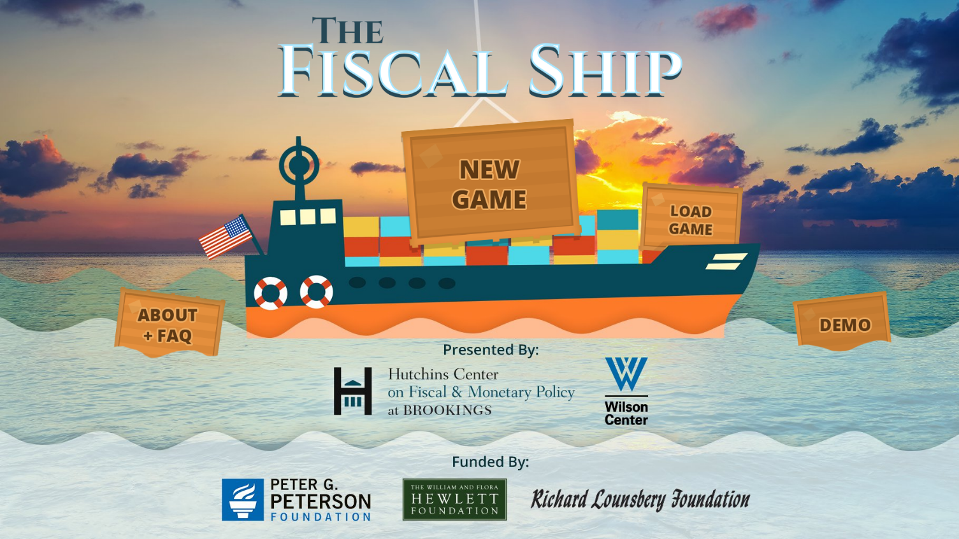
How to play the game
https://www.youtube.com/watch?v=QSWUcaT4GGA

Slide 23
Discussion
How difficult was it to pursue your goals while also hitting the debt target? Which of your goals were most difficult to achieve?
Which of your policy choices had the largest impact on your fiscal target? Which barely moved the line? Were you surprised by the magnitude of any policy choices?
What do you think the political obstacles would be to hitting the debt target?
What do you think would be the impact on the American middle class of the choices you made?
Did the game make you reevaluate your initial governing goals?

Slide 24
“5-Minute-Write”
How should the federal government set the budget on a sustainable course in the next 25 years?

Slide 25
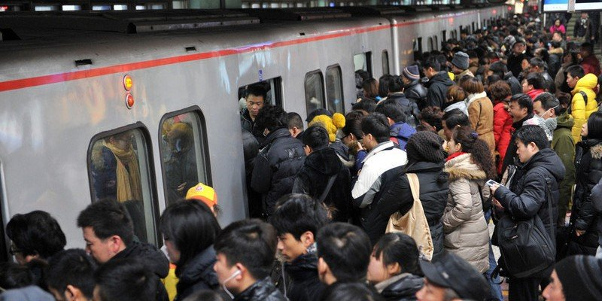
Risk of Government Spending: Crowding Out

Slide 26
Investment Demand Graph
Investment Demand shifts with
Improved economic expectations
Increased expected rate of return
Real Interest Rate
Most of the content in this course will focus on change along the line because of interest rate changes rather than shifts of the line!
ID
ID₁
Quantity of Investment

Slide 27
ALL Loanable Funds
S_{lf}
REAL Interest Rates
i
D_{lf}
Q_{lf}
Quantity of Loanable Funds

Slide 28
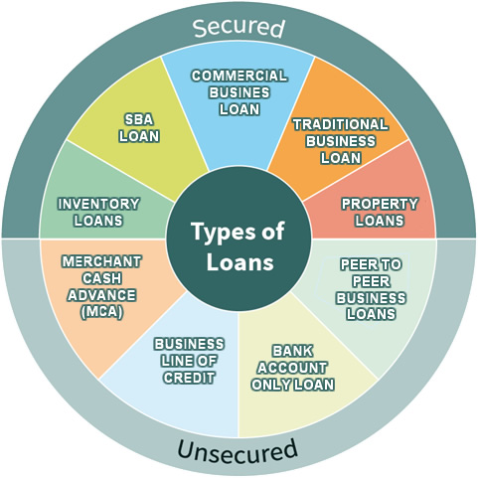
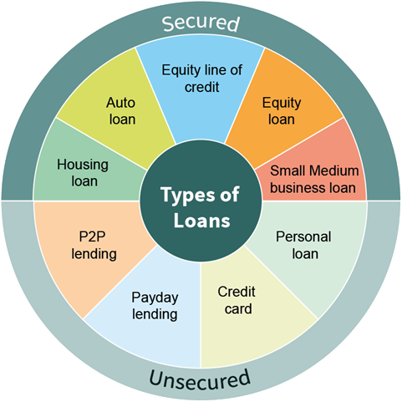

Slide 29
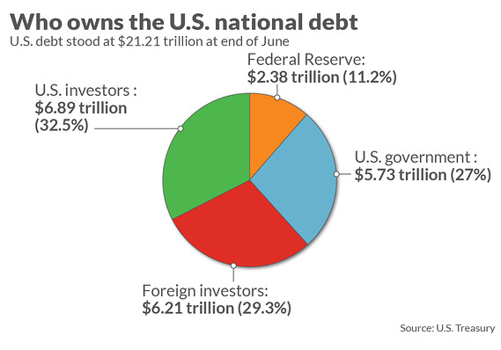
2018

Slide 30
Expansionary fiscal policy
AS/AD Loanable Funds Investment
PL
Real Int. rate
Real Int. rate
rGDP Quantity of LF Q of Investment

Slide 31
Contractionary fiscal policy
AS/AD Loanable Funds Investment
PL
Real Int. rate
Real Int. rate
rGDP Quantity of LF Q of Investment

Slide 32
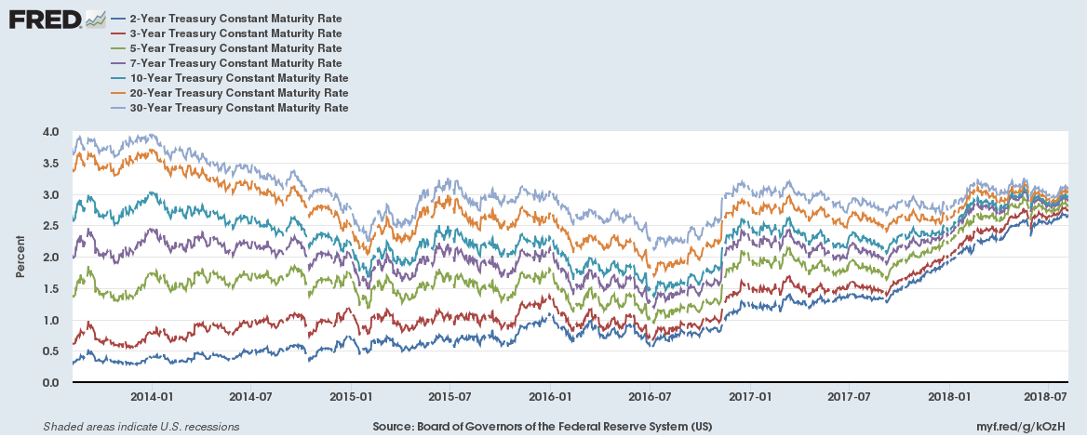

Slide 33
