Slide 1
Domestic factors and economic development
IB Economics
Sara Shackett

Slide 2
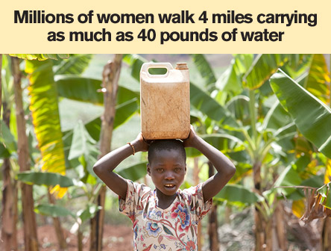
Why women?
What are ways in which women truly suffer in developing countries?
Witches, Half the Sky

Slide 3
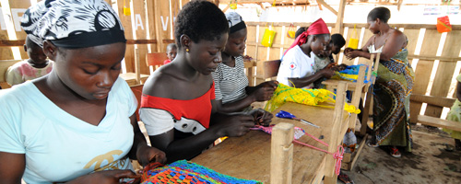
Why women?
What happens when women are empowered?
Let’s draw a cycle of AWESOME!

Slide 4
Women learn about health, hygiene, and diet,
passing health benefits to their children.
Increase education for women
Women and families live longer
The opportunity cost of education decreases as life expectancy increases, so more education
With fewer kids, more/all kids can
be educated
Fewer babies are born to educated women
Spending more time in school reduces the number of reproductive years

Slide 5
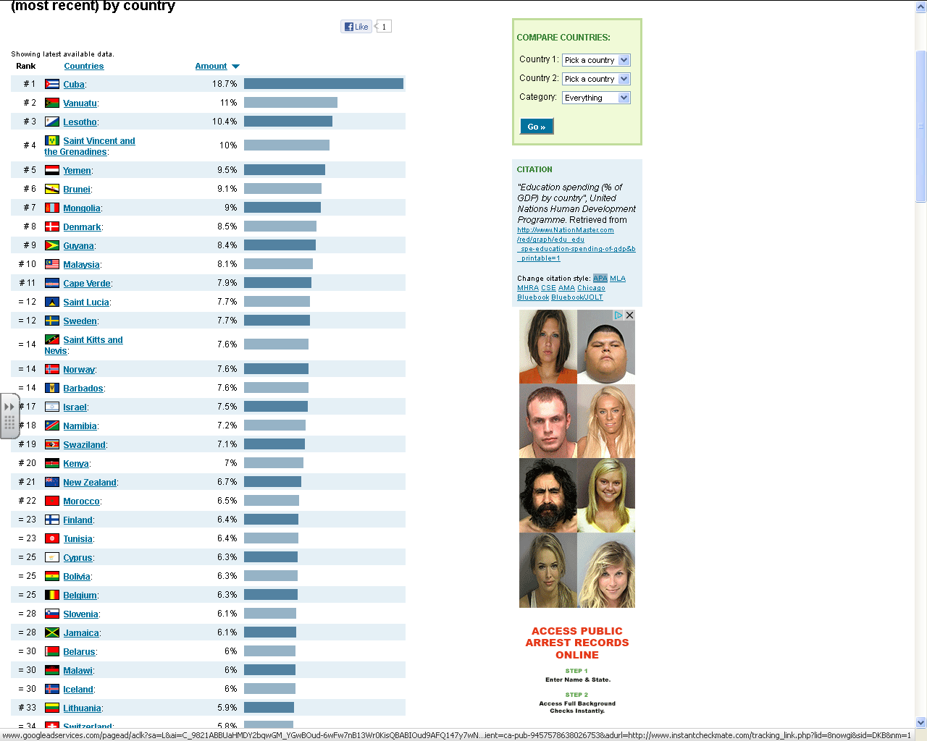
Education

Slide 6
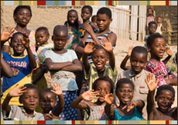
Health care “Healthier is wealthier”
An average additional spending in Sub-Saharan Africa of US$21-36 could in 2015 alone save over 3 million lives, 90% of which would be women and children and generate US$100 billion in economic benefits.
One extra year of life expectancy raises GDP by 4%.

Slide 7
Let’s check out the data on p. 358 and 359 too.

Slide 8
Notes:
Better health - circumcision – reduced risk of AIDS – live longer

Slide 9
Infrastructure
The essential facilities and services such as roads, airports, sewage treatment, water systems, railways, telephone, and other utilities that are necessary for economic activity.
More cycles of AWESEOME from topics on table 29.3 p. 359
Do 1 for DEVELOPMENT and 1 for GROWTH!

Slide 10
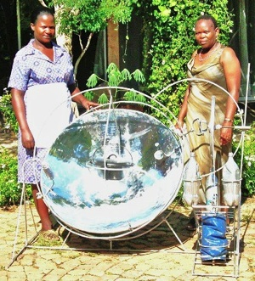
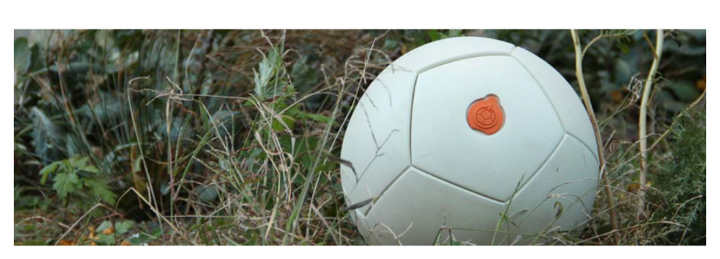
Use of appropriate technology
PRODUCTION
Technology that makes use of abundant labor supply
e.g. capital equipment that’s cheap and requires labor for its use.
CONSUMPTION
Solar cooker is cheap and doesn’t require wood
How does this contribute to development?

Slide 11
Political stability and lack of corruption
In the past 12 months, have you or anyone living in your household paid a bribe of any sort?
TRANSPARENCY INTERNATIONAL
Bribery, extortion, fraud, patronage, influence peddling, nepotism
Affects growth and development
Governments aren’t accountable
Governments spend tons on large scale capital investment projects
Jenky official accounting practices
Poorly paid officials
Lack of democracy
Weak legal structure
Lack free speech

Slide 14
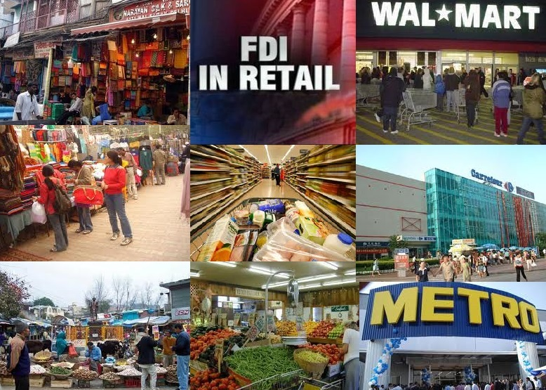
Political stability and lack of corruption, cont.
Foreign Direct Investment: direct investment into production or business in a country by a company in another country, either by buying a company in the target country or by expanding operations of an existing business in that country.

Slide 15
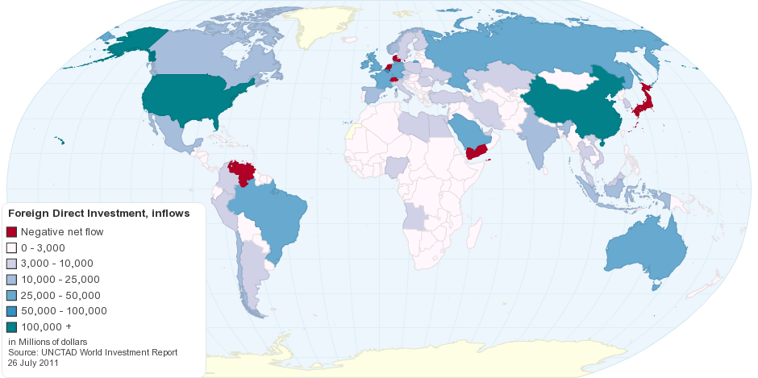

Slide 16
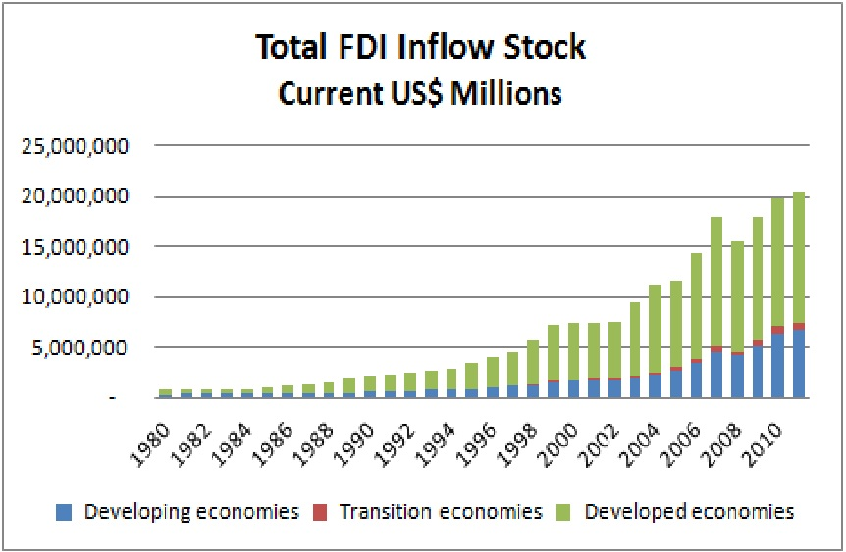

Slide 17
Legal system
PROPERTY RIGHTS “basket”
Own assets (land, buildings)
Establish the use of our assets (add to building)
Benefit from assets (rent land)
Sell our assets
Exclude others from using or taking over our assets
Why does economic growth depend on well-enforced property rights?
How does this issue affect development?

Slide 18
Taxation
Tax collection issues in developing countries
Poor population
Corrupt administration
Inefficient administration
Large informal market
Corporate tax revenues low too
Little corporate activity
Large tax incentives to encourage corporate activity and attract FDI
Main revenue source is tariffs
Depends on foreign trade
≤3% pay income tax in LDC compared to 60%-80% in developed countries

Slide 19
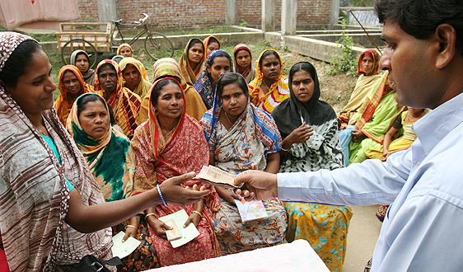
Financial system, credit, microfinance
FINANCIAL MARKETS: institutions where lending and borrowing is carried out
Official
Unofficial
Issue of saving
MICROECREDIT: provision of small loans to individuals who have no access to traditional sources
Banker to the Poor ch. 3
Grameenbank video

Slide 20
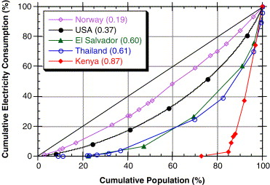
Income distribution
Why is high income inequality a barrier to G&D?

