Slide 1
IB Writing Skills Practice

Slide 2
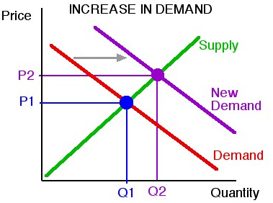
A few determinants of demand are…
When demand ______________, the quantity…
The price…
…because the law of supply states that…

Slide 3
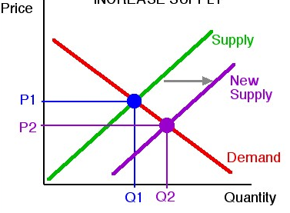
A few determinants of supply are…
When supply ______________, the quantity…
The price…
…because the law of demand states that…

Slide 4
A few determinants of supply are…
When supply ______________, the quantity…
The price…
…because the law of demand states that…

Slide 5
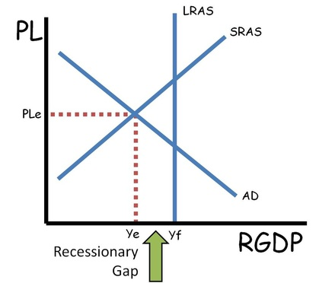
Figure 1 demonstrates a(n) ____________________ gap.
Two demand-side policies that can correct the gap include…
The result will be a shift in AD to the ___________, causing output to ___________, the price level to ___________, and unemployment to _________.

Slide 6
According to the neo-classical model, the economy is self-correcting. In the long run, the ___________ will shift because…
The long-run equilibrium is at full employment, which means…

Slide 7
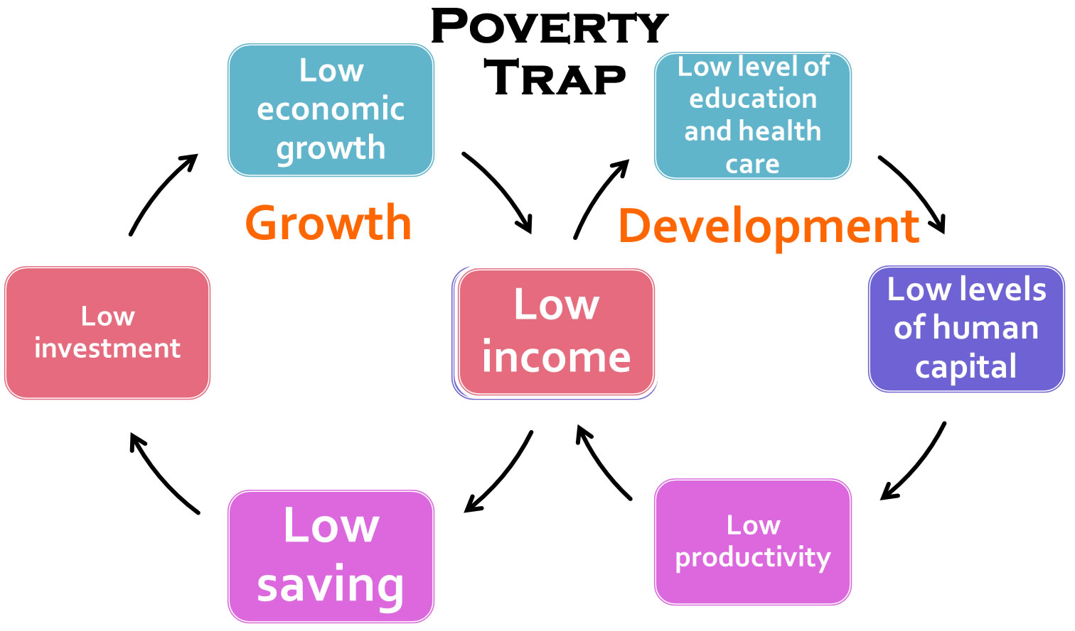
Figure 1 is a ________________.
When people in an LDC have low incomes…

Slide 8
DISTINGUISH EXPLAIN
Part A verbs

Slide 9
Make clear the differences between two or more concepts or items. DISTINGUISH Give a detailed account including reasons or causes. EXPLAIN
Part A verbs

Slide 10
Explain why senioritis is a problem.
Give a detailed account including reasons or causes. EXPLAIN

Slide 11
A fall in income leads to a fall in demand for a good. Explain this relationship between the demand for the good and consumer income.
Give a detailed account including reasons or causes. EXPLAIN

Slide 12
Distinguish between the effect of an increase in income and an increase in the price of a good on the demand for the good.
Make clear the differences between two or more concepts or items. DISTINGUISH

Slide 13
Distinguish between your experiences as a middle school student and a high school student.
Make clear the differences between two or more concepts or items. DISTINGUISH

Slide 14
TO WHAT EXTENT DISCUSS EVALUATE
Part B verbs

Slide 15
TO WHAT EXTENT DISCUSS Make an appraisal by weighing up the strengths and limitations. EVALUATE
Part B verbs

Slide 16
Evaluate the effectiveness of Lakewood’s dress code policy.
Make an appraisal by weighing up the strengths and limitations. EVALUATE

Slide 17
Evaluate the effectiveness of fiscal policy to reduce the rate of inflation.
Make an appraisal by weighing up the strengths and limitations. EVALUATE

Slide 18
Evaluate the view that the best way to reduce income inequality in a country is by using progressive taxation.
Make an appraisal by weighing up the strengths and limitations. EVALUATE

Slide 19
TO WHAT EXTENT Offer a considered and balanced review that includes a range of arguments, factors or hypotheses. DISCUSS Make an appraisal by weighing up the strengths and limitations. EVALUATE
Part B verbs

Slide 20
Discuss the view that Tiger Time should be moved to the end of the day.
Offer a considered and balanced review that includes a range of arguments, factors or hypotheses.
DISCUSS

Slide 21
Discuss the view that deflation will always be bad for an economy.
Offer a considered and balanced review that includes a range of arguments, factors or hypotheses.
DISCUSS

Slide 22
Discuss the view that price controls imposed by governments on the market for rented housing should never be used.
Offer a considered and balanced review that includes a range of arguments, factors or hypotheses.
DISCUSS

Slide 23
Consider the merits or otherwise of an argument or concept. TO WHAT EXTENT Offer a considered and balanced review that includes a range of arguments, factors or hypotheses. DISCUSS Make an appraisal by weighing up the strengths and limitations. EVALUATE
Part B verbs

Slide 24
“I have done my best this school year.” To what extent is this statement valid?
Consider the merits or otherwise of an argument or concept. TO WHAT EXTENT

Slide 25
“An increase in aggregate demand may not lead to an increase in real national income.” To what extent is this statement valid?
Consider the merits or otherwise of an argument or concept. TO WHAT EXTENT

Slide 26
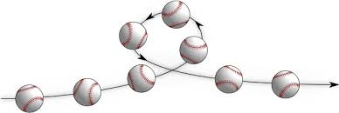

Slide 27
Consider an argument or concept in a way that uncovers the assumptions and interrelationships of the issue.
EXAMINE
2018 prompt

Slide 28
Examine the significance of going 1:1 with Chromebooks for Lakewood High School.
Consider an argument or concept in a way that uncovers the
assumptions and interrelationships of the issue.
EXAMINE

Slide 29
Examine the significance of both cross price elasticity of demand and income elasticity of demand for a firm.
Consider an argument or concept in a way that uncovers the
assumptions and interrelationships of the issue.
EXAMINE

Slide 30
Paper 2 Verbs

Slide 31
D Discuss Evaluate Compare and contrast
B & C Explain

Slide 32
Give an account of similarities and differences between two (or more) items or situations, referring to both (all) of them throughout. COMPARE AND CONTRAST
Paper 2 additional verb

